Slide 1
Time Series Project
Analysis of Hong Kong Market Data
Jason Herbaugh and Alexander Sepenu

Slide 2
Data Set Summary
Data: https://www.kaggle.com/stanley11291985/hk-macroeconomics-data
Economic data for the Hong Kong Private Housing Market
  Collected between 2003 and 2019
  Variables include:
    Hang Seng Index (total volume and close price)
    Index data for Consumer Price and Private Domestic Housing
    Unemployment Rate and Bank Interest Rate
    Inventory (built/sold/vacant)
    Sales Metrics (quantity/amount)
No Missing Data or Outliers
EDA Project: https://github.com/jherbaugh/MSDS6373_TS_Project

Slide 3
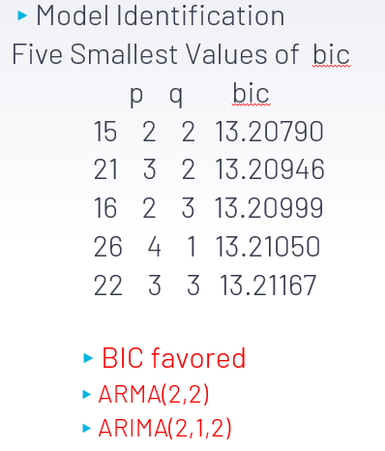
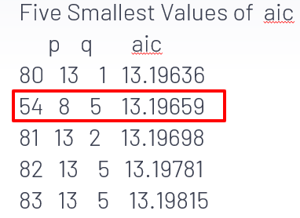
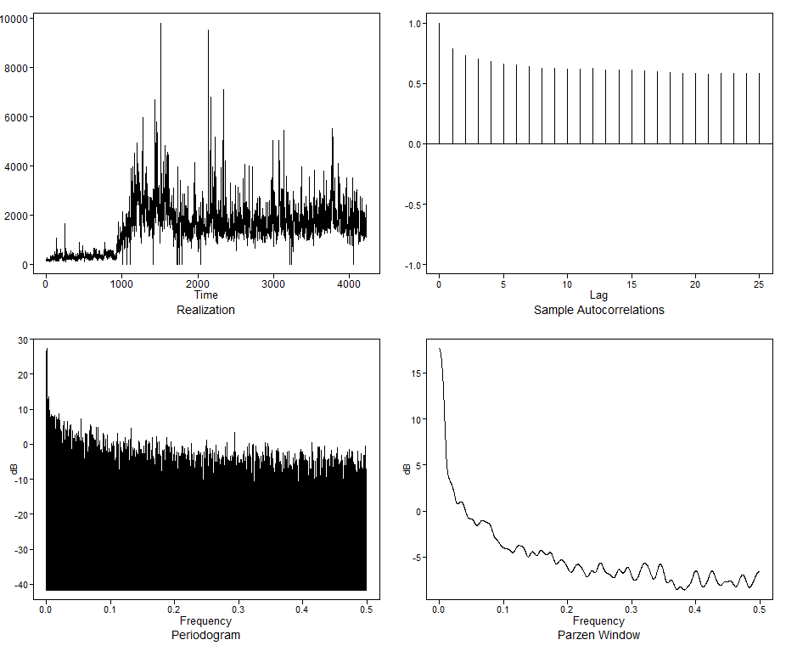
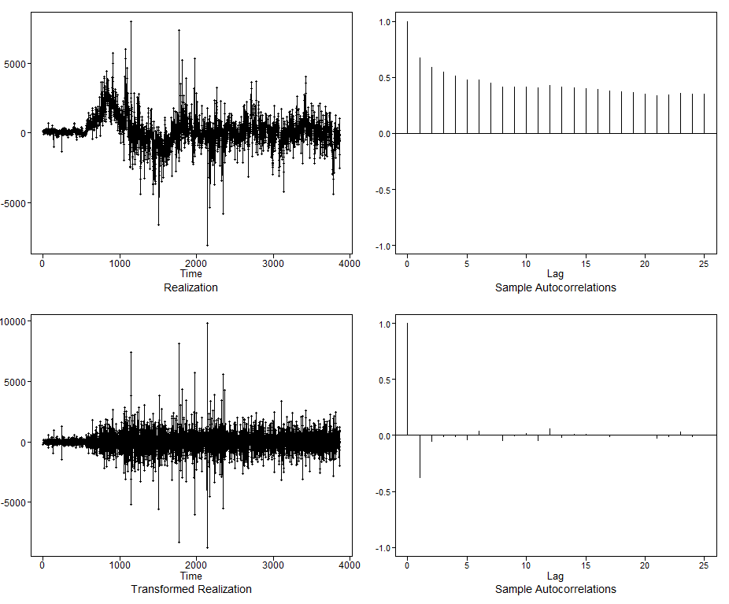
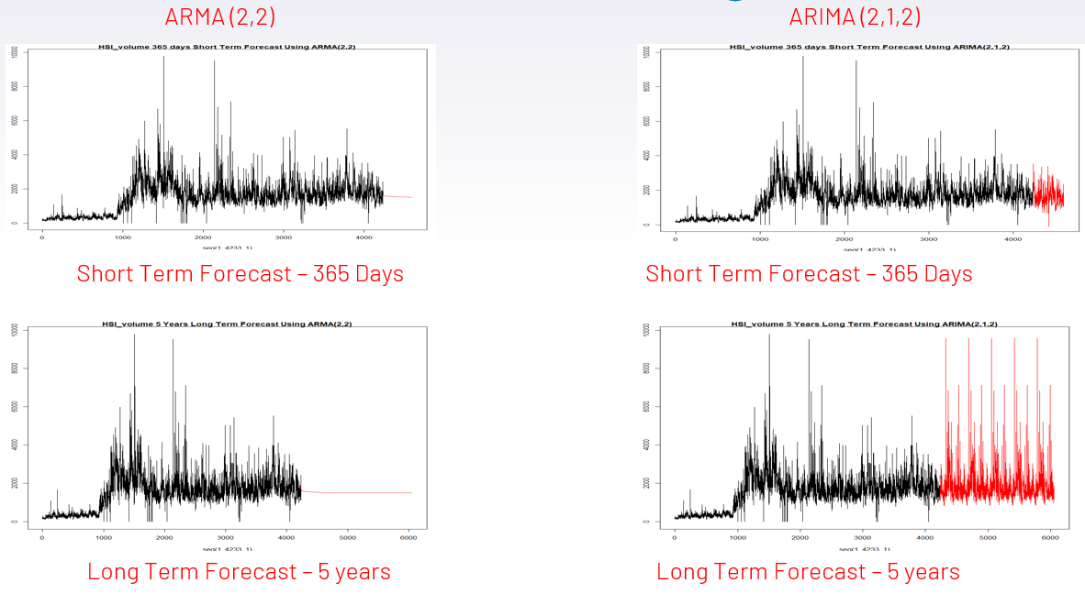
Univariate Analysis – Hang Seng Index (HSI) Volume
Before Differencing
After Differencing
Model Forecast

Slide 4
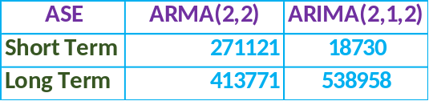

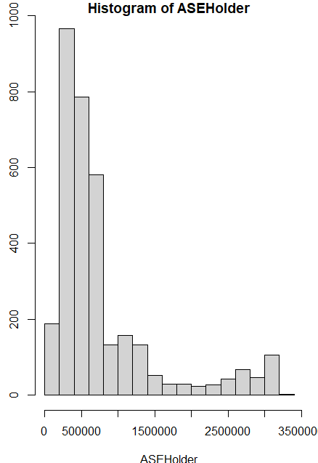
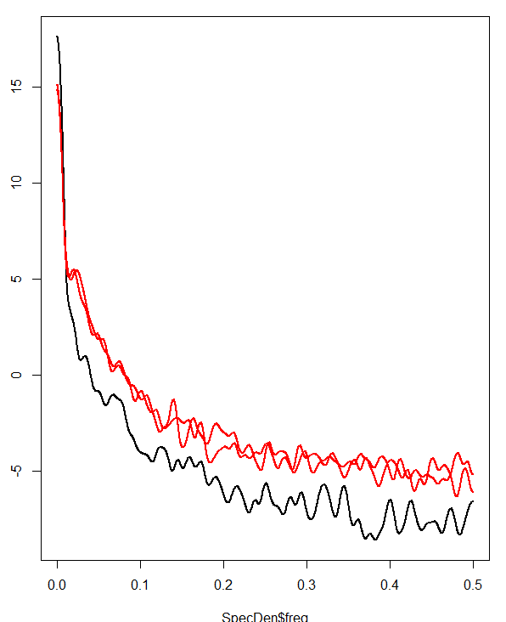
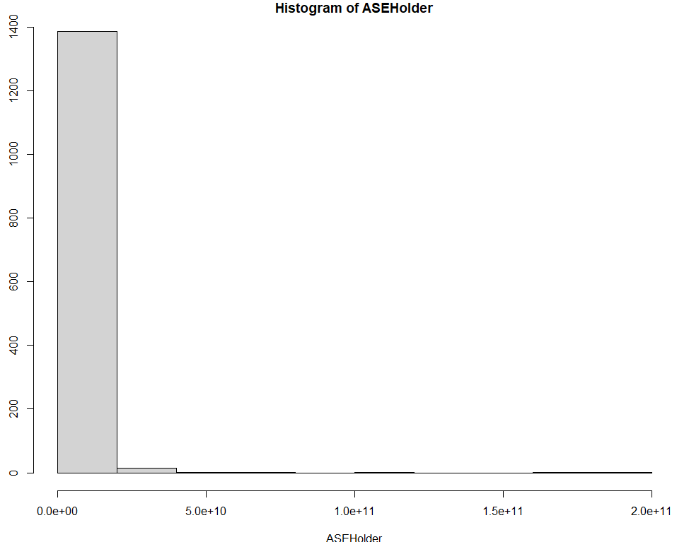
HSI Volume – Model Evaluation
Short Term Rolling ASE
ARMA(2,2) Model Spectral Density is Consistent with Actual Spectral Density for Series
Long Term Rolling ASE

Slide 5
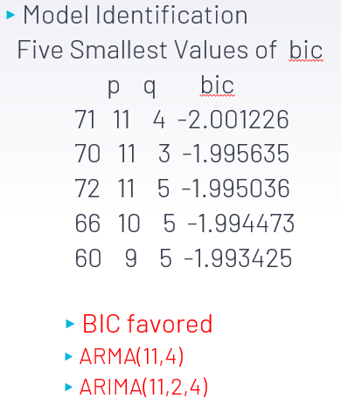
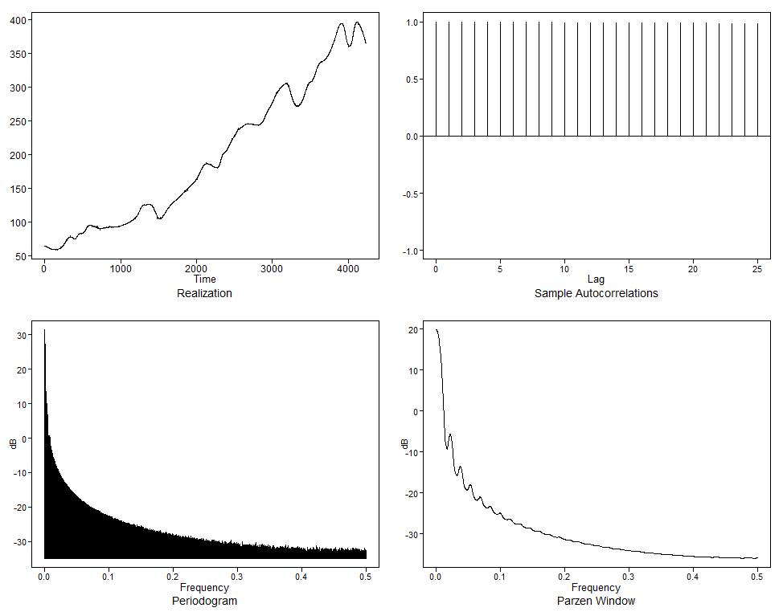
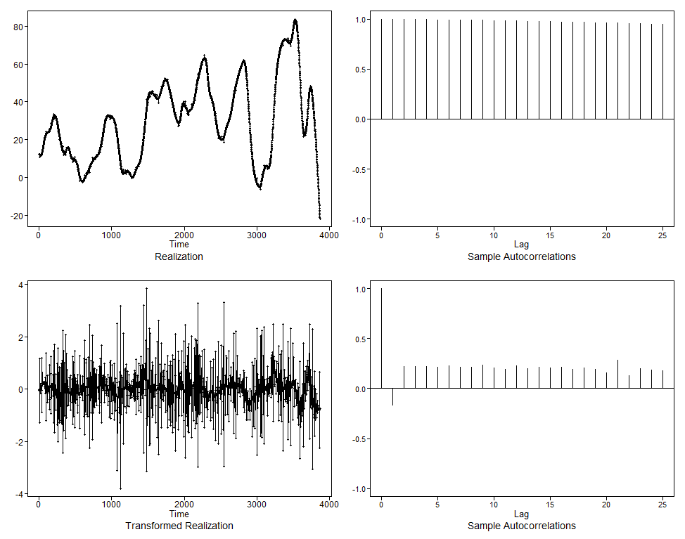
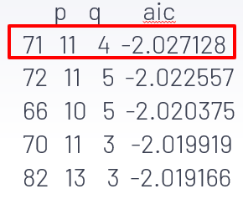
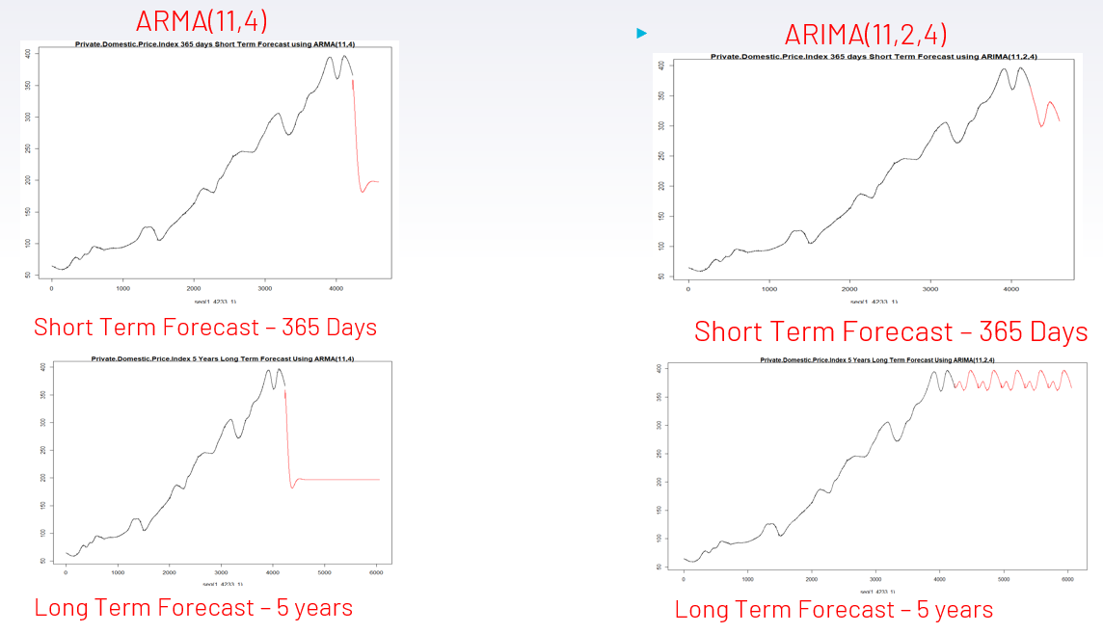
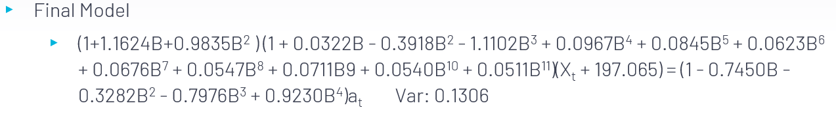
Univariate Analysis – Price Index
Before Differencing
After Differencing
Model Forecast

Slide 6
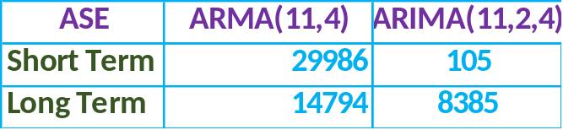
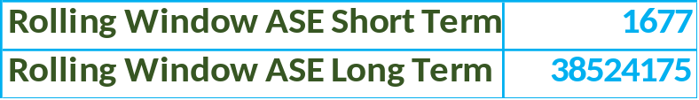
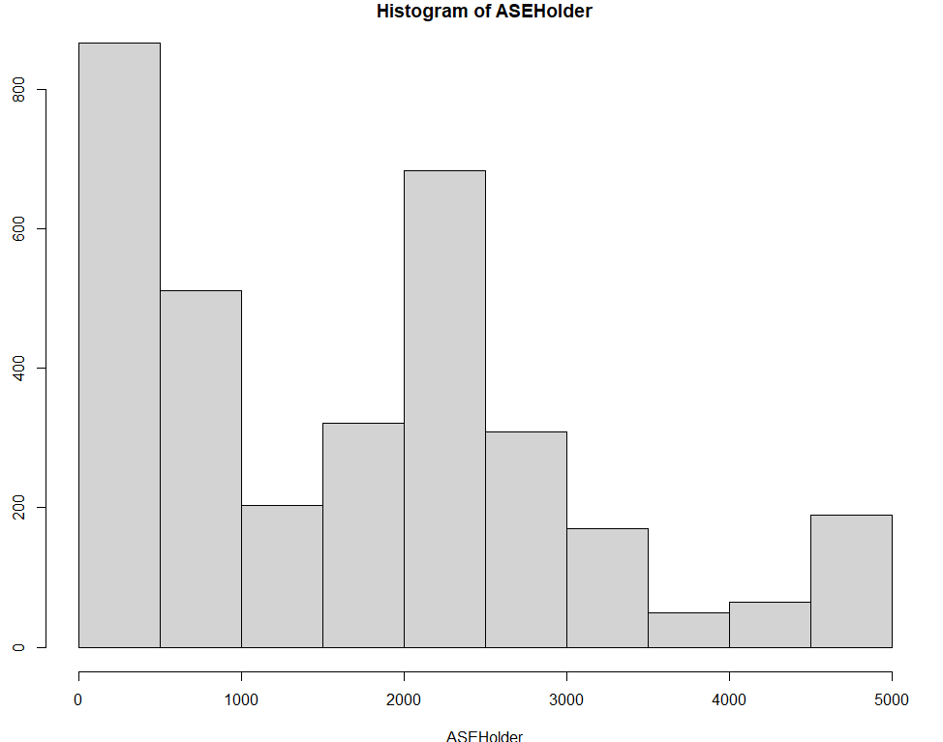
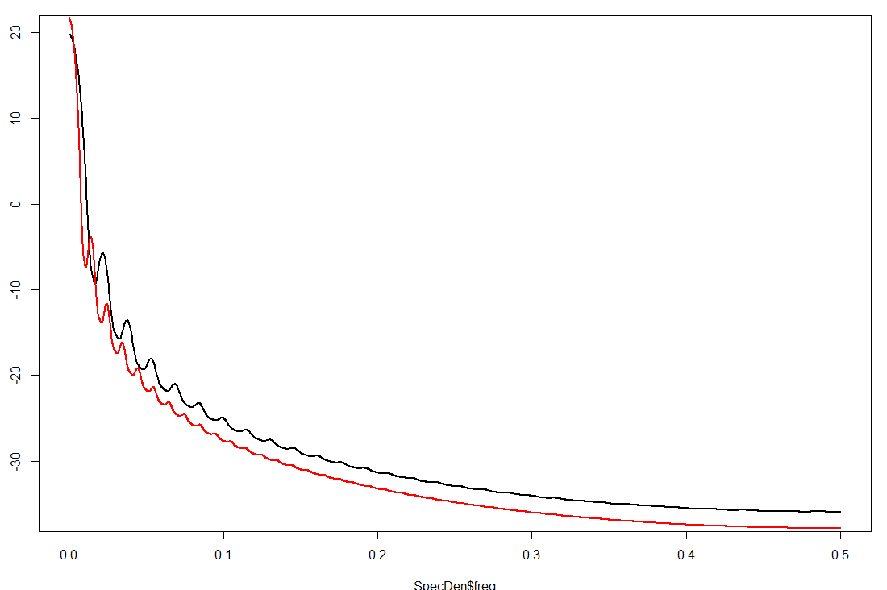
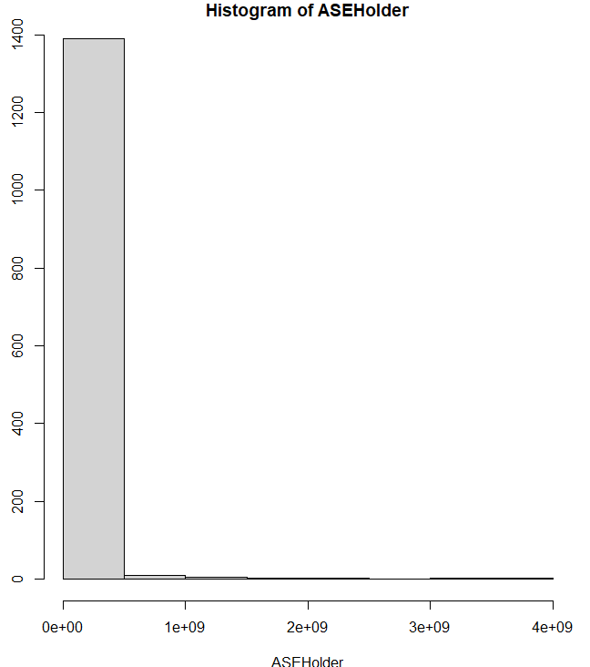
Price Index– Model Evaluation
Short Term
Rolling ASE
ARIMA (11,2,4) Model Spectral Density is Consistent with Actual Spectral Density for Series
Long Term
Rolling ASE

Slide 7
Action Plan
Short-term investment is likely to yield high return
  Investigate if other economic indicators in this data set suggest otherwise?
Will multi-indicators forecast a short- or long-term investment
Are there any hidden trends in data using a lag function?

